Slide 1
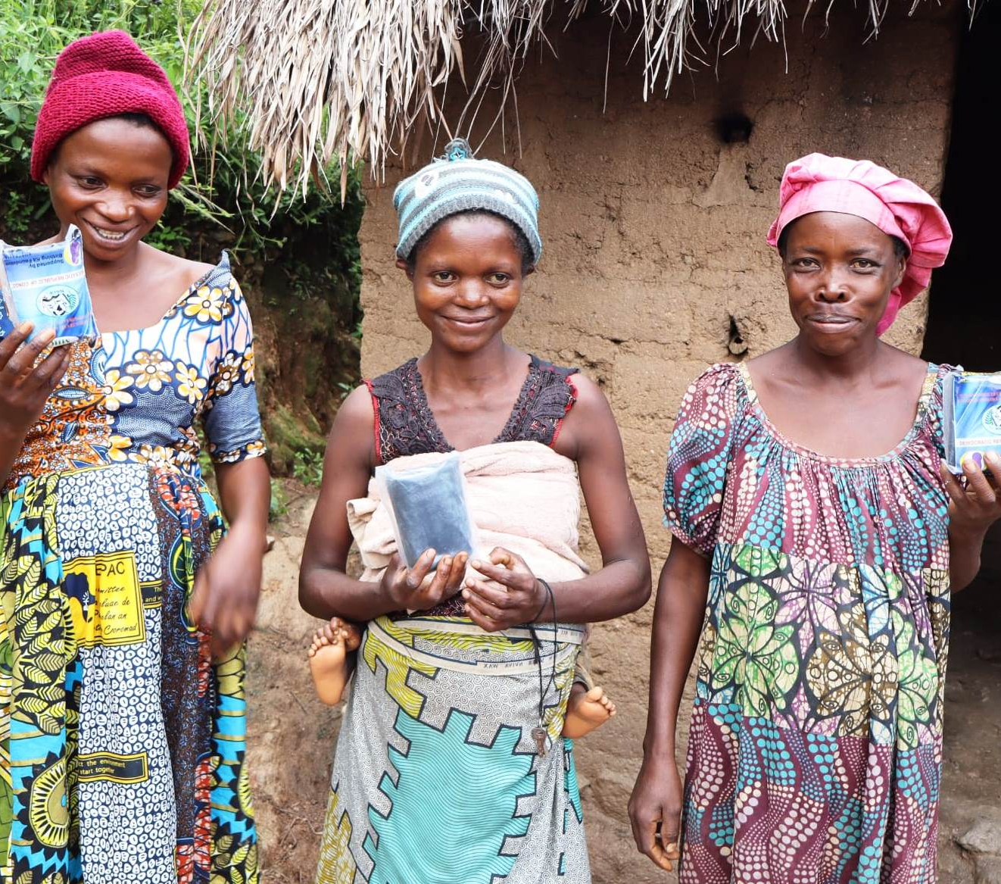

Slide 2
A Brief History
1999
The first birthing kits were made in Adelaide, South Australia, by members of the Zonta Club of Adelaide Hills. These kits were bound for Papua New Guinea.
2004
The project was accepted as a District Project by Australian Zonta Districts 22, 23 and 24 and kits were now being made as part of the Zonta Birthing Kit Project.
2006
Birthing Kit Foundation Australia was established.
2024
Over 2.8 million kits have been packed and distributed to women overseas.

Slide 3
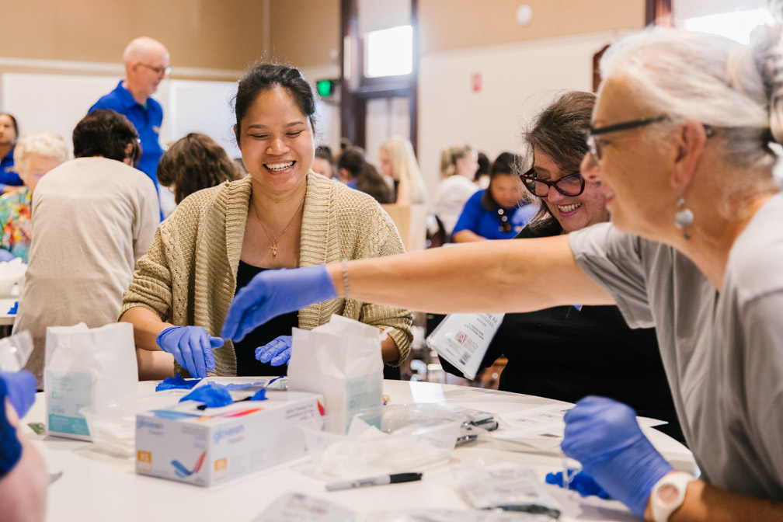
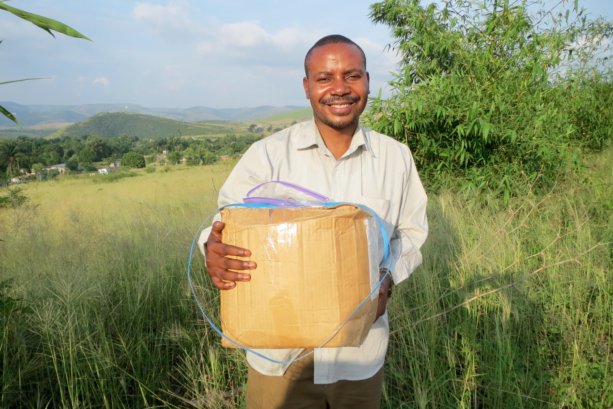
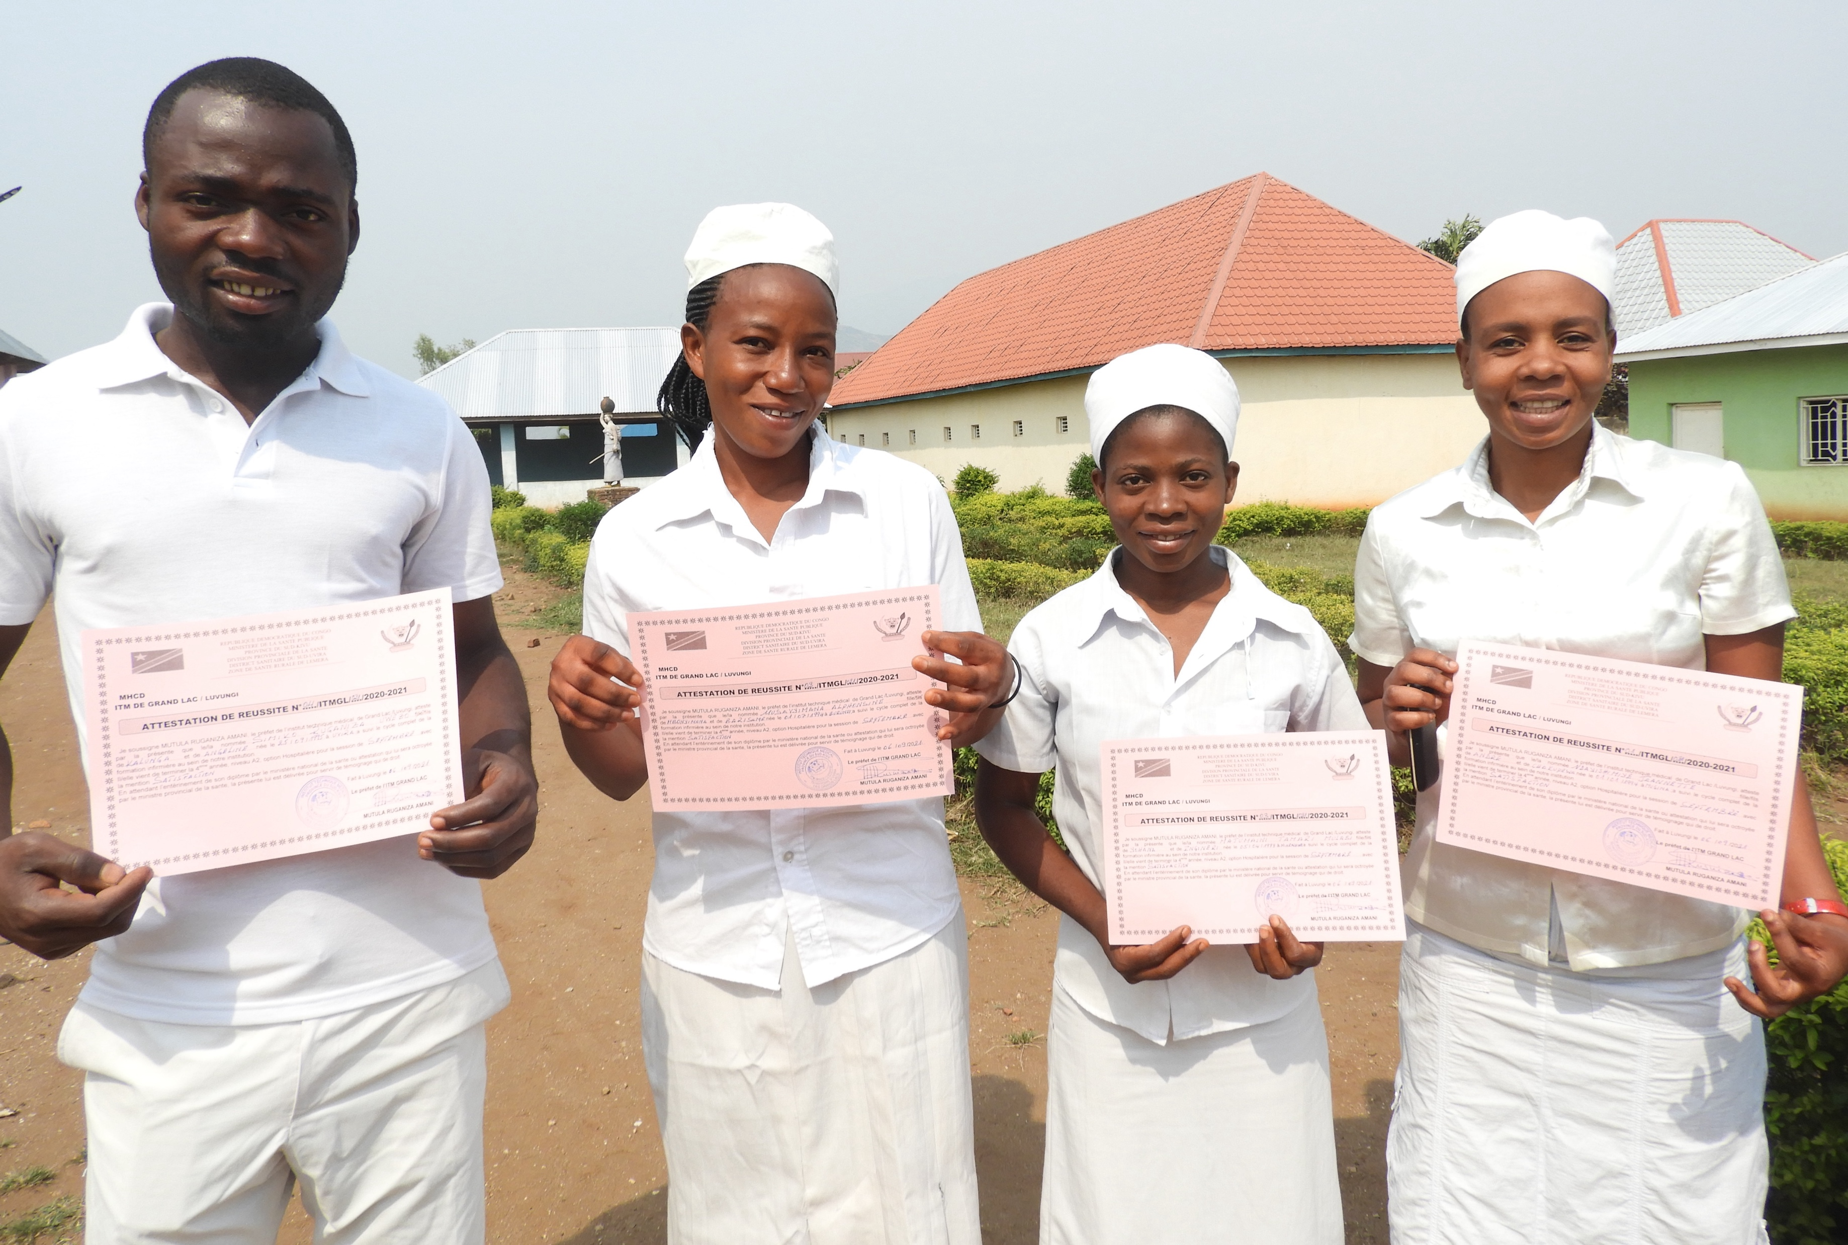
What does BKFA do?
provides funding for community development projects, supported by research and advocacy for improved maternal and newborn outcomes.
establishes partnerships with approved field organisations in developing countries who receive and distribute Birthing Kits to vulnerable women.
provides an opportunity for Australian volunteers to fundraise for and engage in the assembly of Birthing Kits.

Slide 4
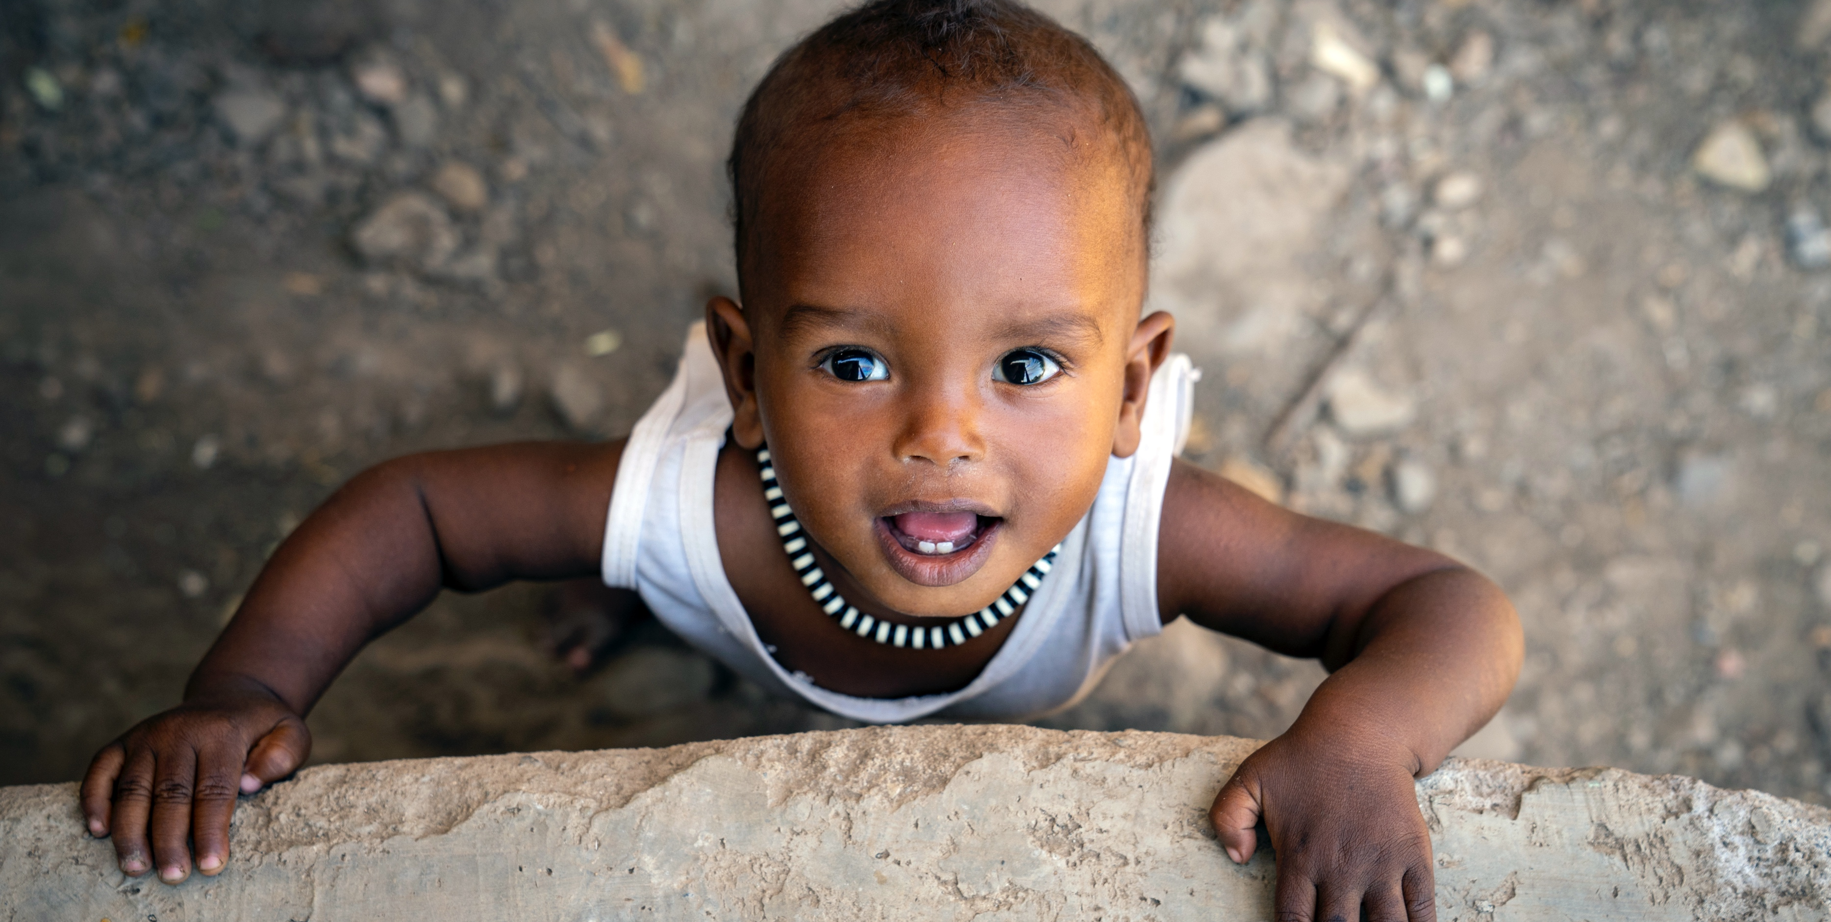
Our Vision and Mission
Mission
To positively impact the lives of mothers and babies in developing countries.
To partner with and empower our partner organisations and communities.
To enable systems where women and girls become truly empowered.
Vision
A world in which all women and girls have access to a clean and safe birth.

Slide 5
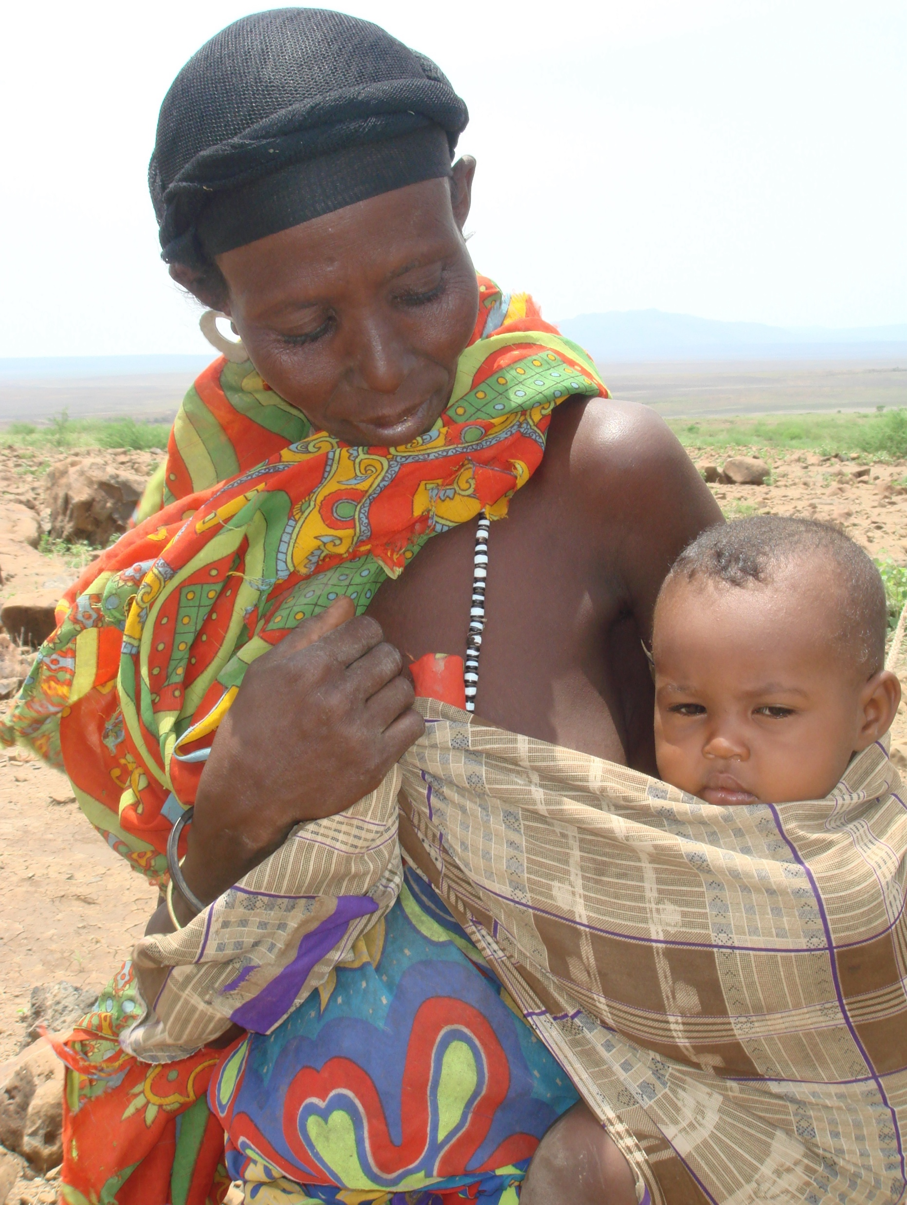
What is a Birthing Kit?
Birthing Kits are an internationally accepted intervention to support a clean birth.
Each item in the BKFA birthing kit works to reduce infections at key high-risk moments of care during labour, birth and immediately post-birth for the mother, newborn and birth attendant.
WHO, UNICEF and UNFPA recommendations* include:
• The use of a clean delivery surface
• That the eyes of the baby are wiped clean
• That ties and a blade should be used to tie and cut the cord.
BKFA birthing kits are similar to the kits distributed by large UN entities for use in emergency response settings.
*‘Pregnancy, Childbirth, Postpartum and Newborn Care: A guide for essential practice, Third edition’

Slide 6
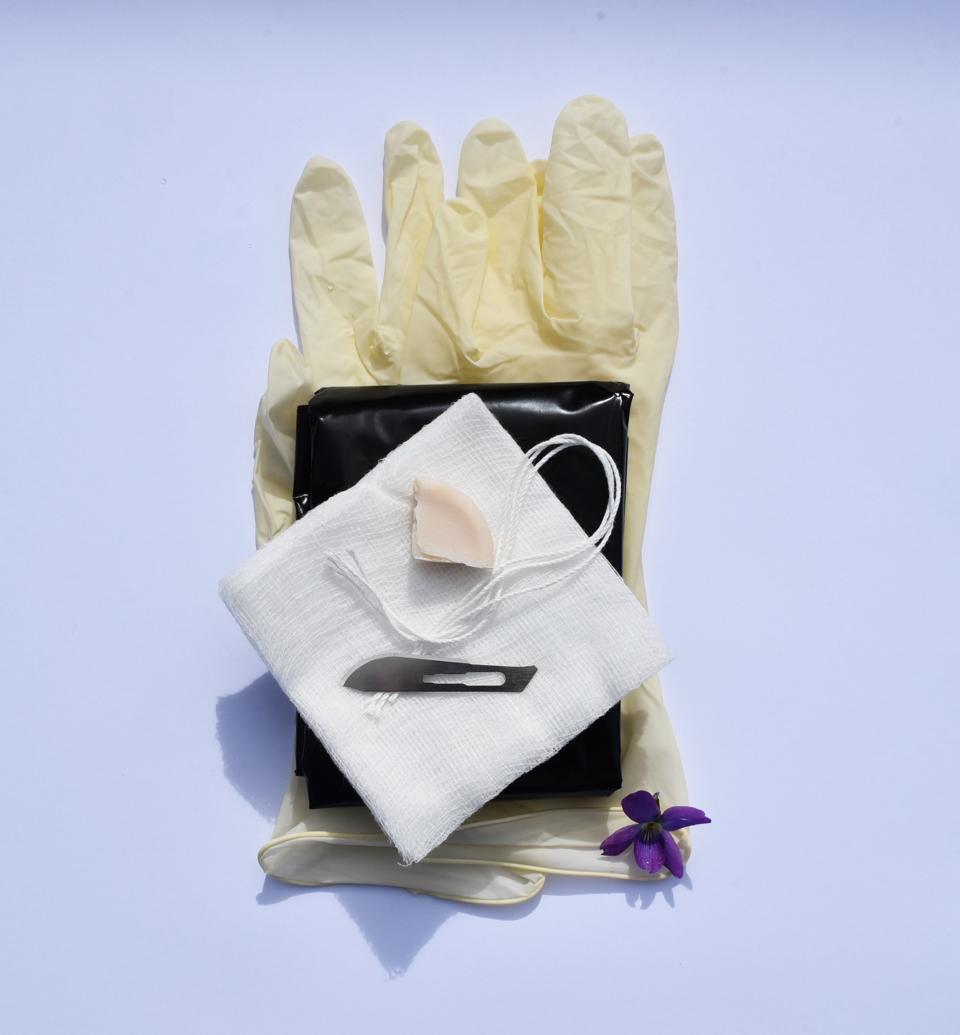
What’s in a Birthing Kit?
A plastic sheet to prevent the mother and newborn coming into contact with the ground or an unhygienic surface.
A sterile blade to cut the umbilical cord cleanly and reduce risk of newborn sepsis and tetanus.
Gloves to cover the birth attendant's hands and provide protection from infections such as HIV for carers and care recipients.
Clean cord ties to tie the umbilical cord.
Gauze to wipe clear the newborn baby’s eyes, and to clean the mother’s perineum prior to giving birth.
Soap to wash the birth attendant’s hands and the mother’s perineum.

Slide 7
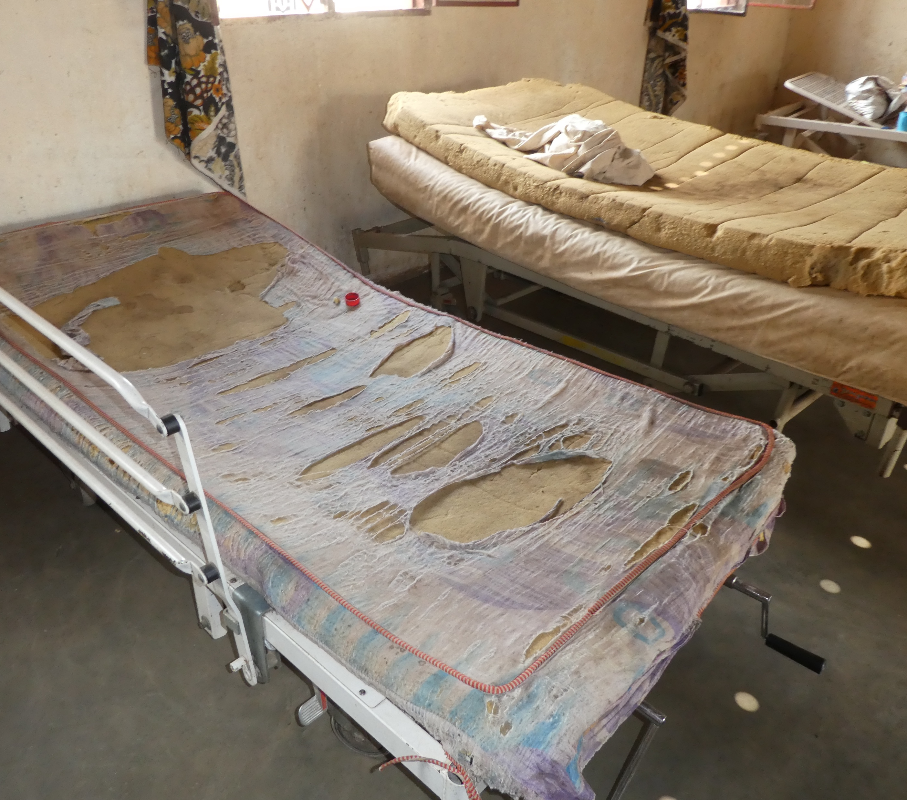
Why are Birthing Kits needed?
It is estimated that over 300,000 women (mostly in developing countries) die annually in childbirth - many from preventable infections.
Infection, such as sepsis, acquired during or directly after childbirth, is one of the leading causes of newborn and maternal death.
Good hygiene is critical in eliminating infection during and after childbirth.
By providing a clean birthing kit, mothers giving birth at home or with limited medical support have the resources to reduce infection.

Slide 8
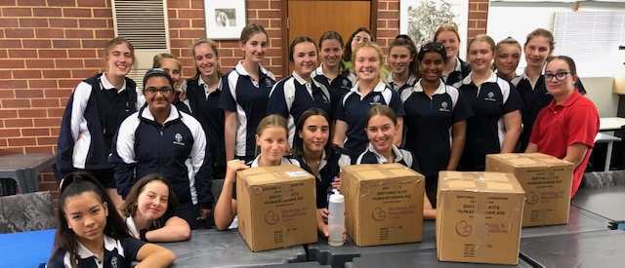
How are they made?
Australian Volunteers
In-Country
By volunteers who fundraise and assemble the kits at Assembly Days in Australia.
By Field Partners who are funded by BKFA to manage the procurement and assembly of birthing kits in-country.

Slide 9
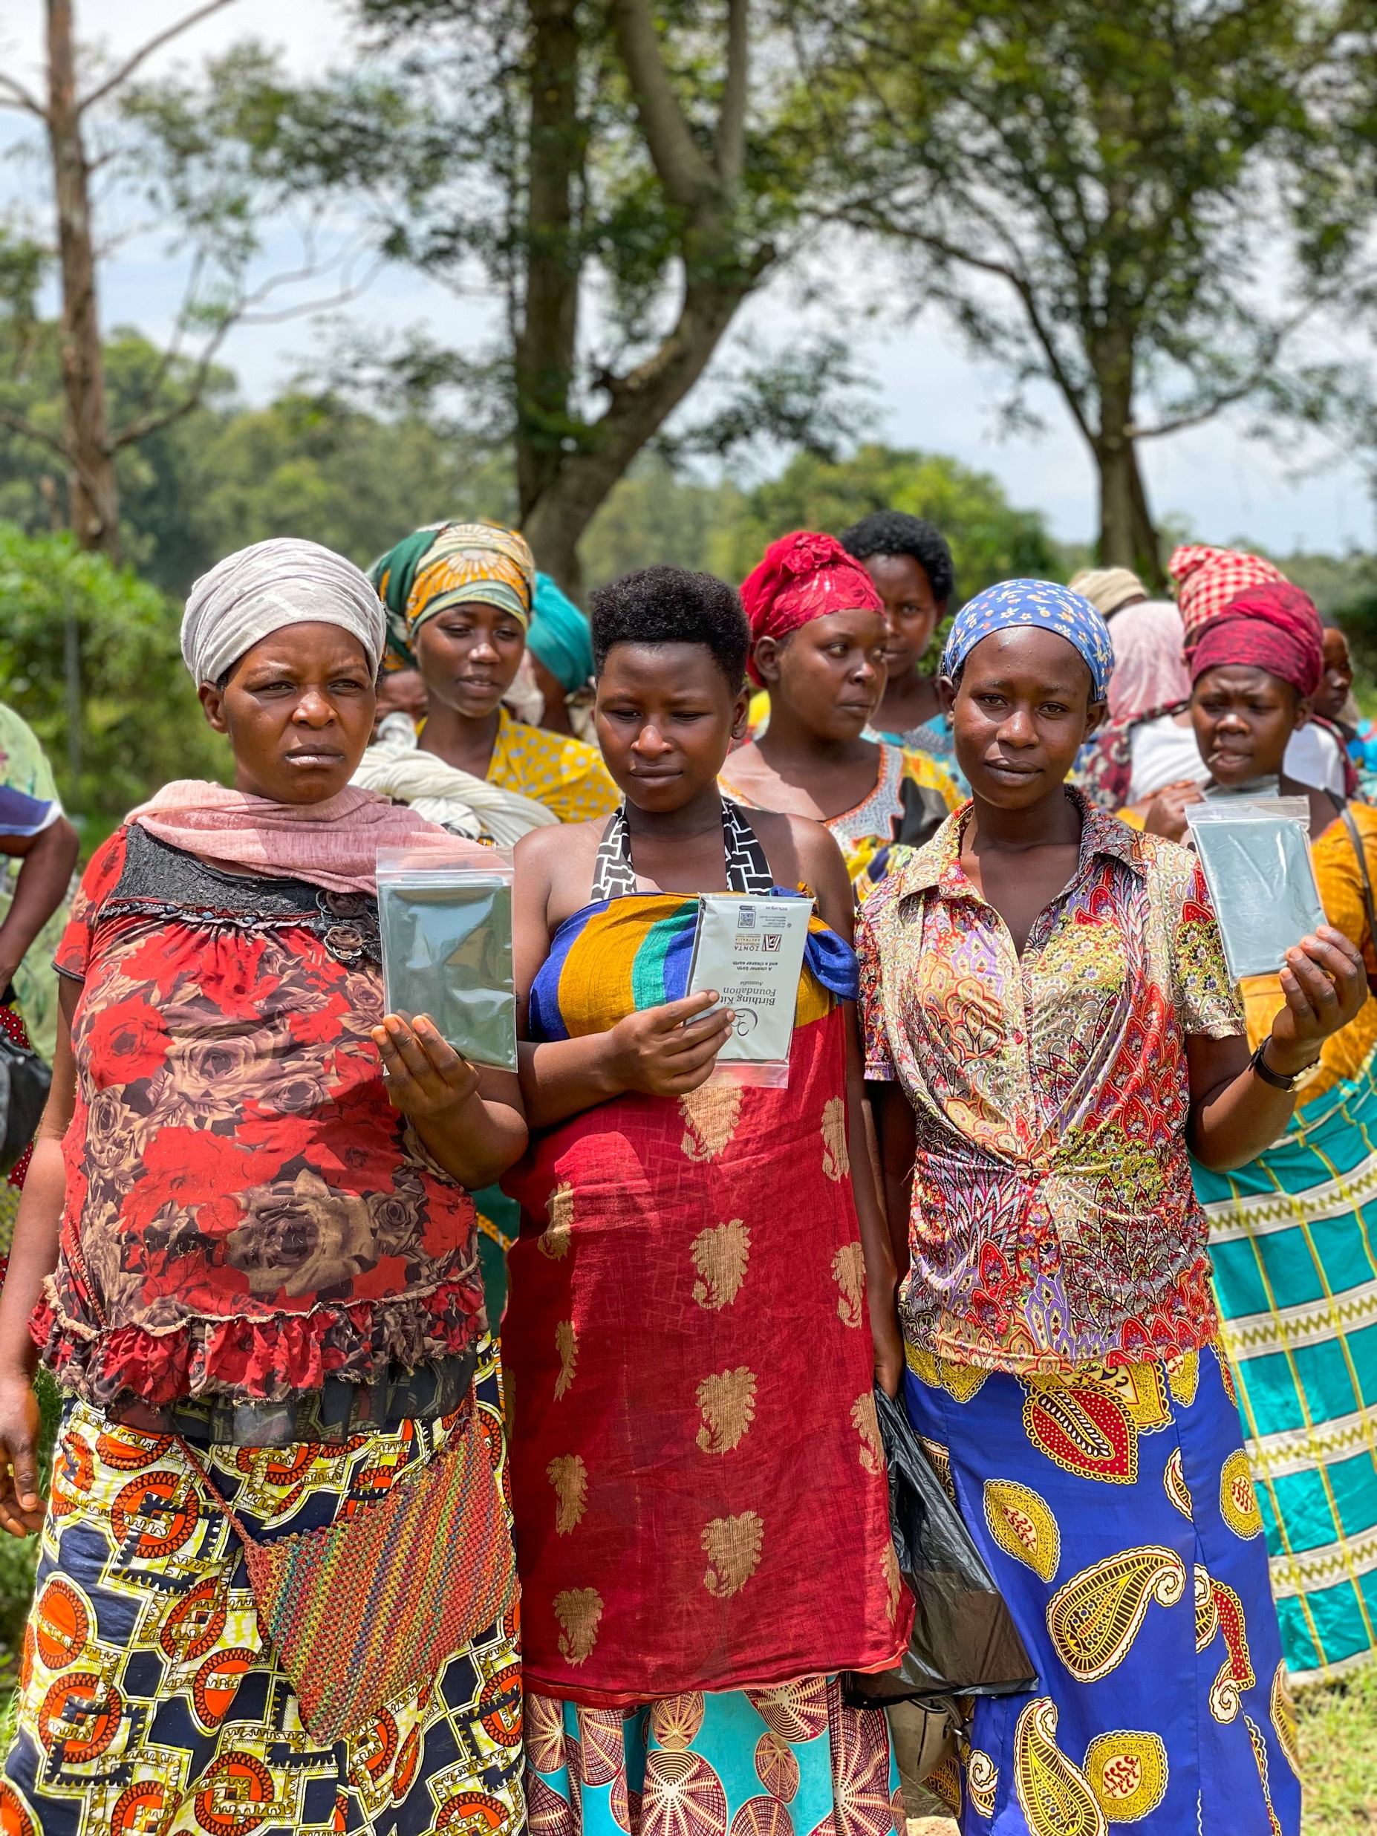
Who receives them?
BKFA currently works with over 31 organisations in 11 countries in Africa, the Pacific and the Caribbean.
BKFA sends birthing kits free of charge to organisations who have been approved as a BKFA Field Partner.
Birthing Kits have most impact in settings where no other resources are available and where a larger percentage of mortalities are attributed to unclean deliveries. BKFA therefore targets regions of developing countries with a high incidence of unclean birth practices.

Slide 10
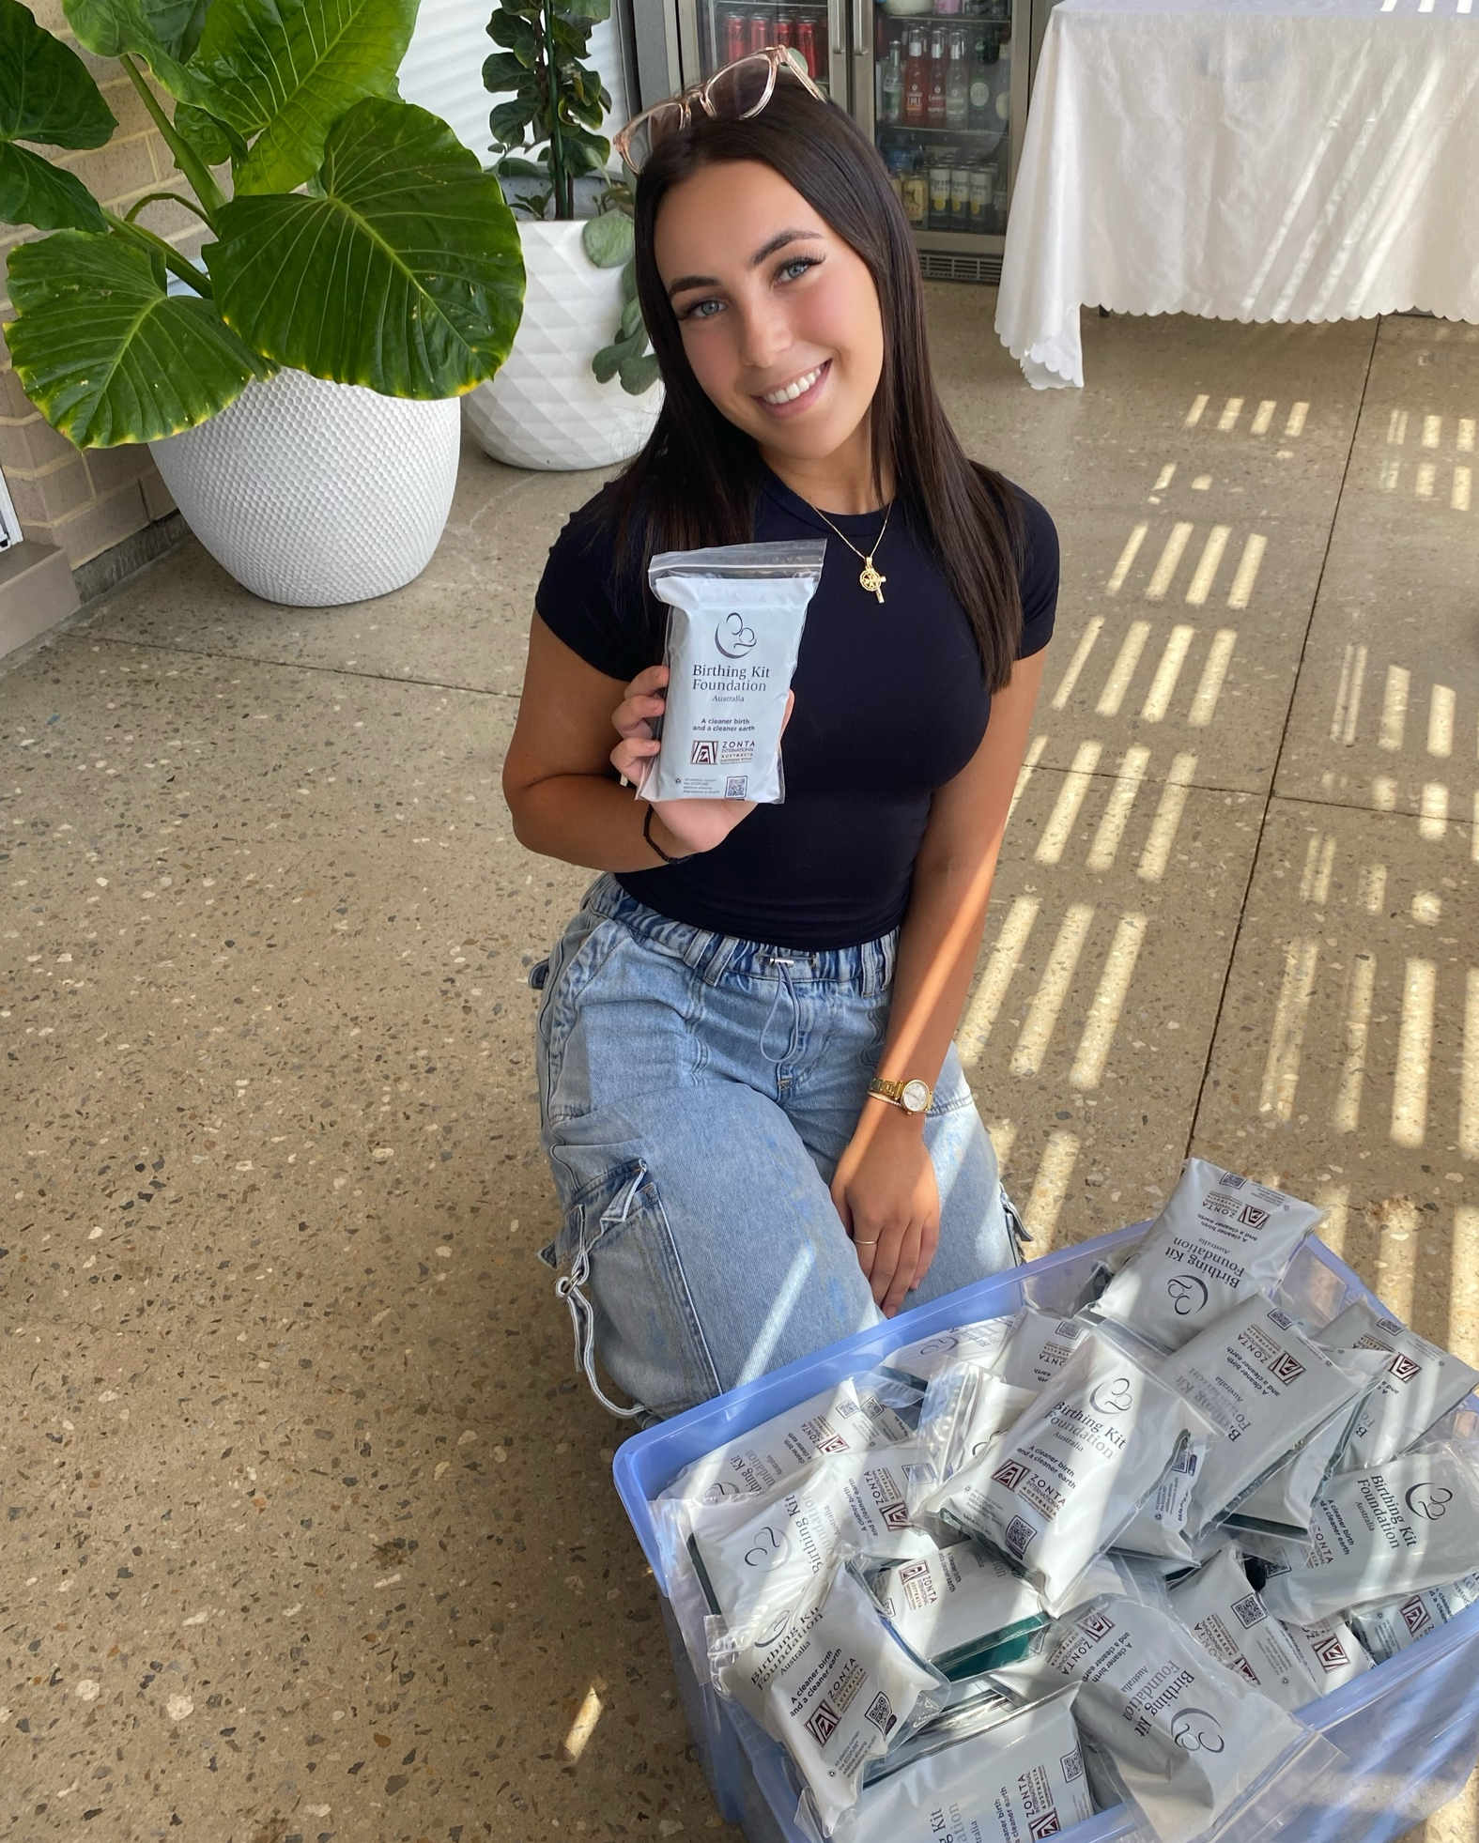
Thank You
Website
bkfa.org.au
Facebook
@BirthingKitFoundationAu
Instagram
@bkfa.au
YouTube
bit.ly/bkfayoutube

